Slide 1
PROJECT FOR LEAN SIX SIGMA GREEN BELT INCREASING HOSPITAL POS COLLECTIONS

Slide 2
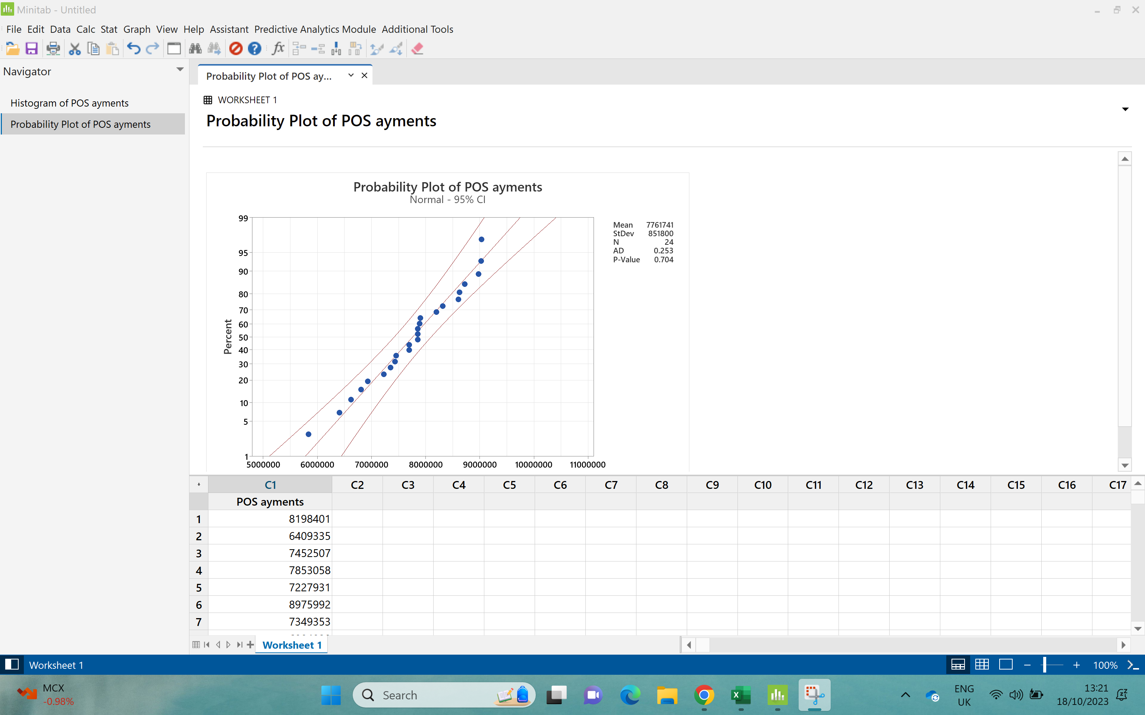
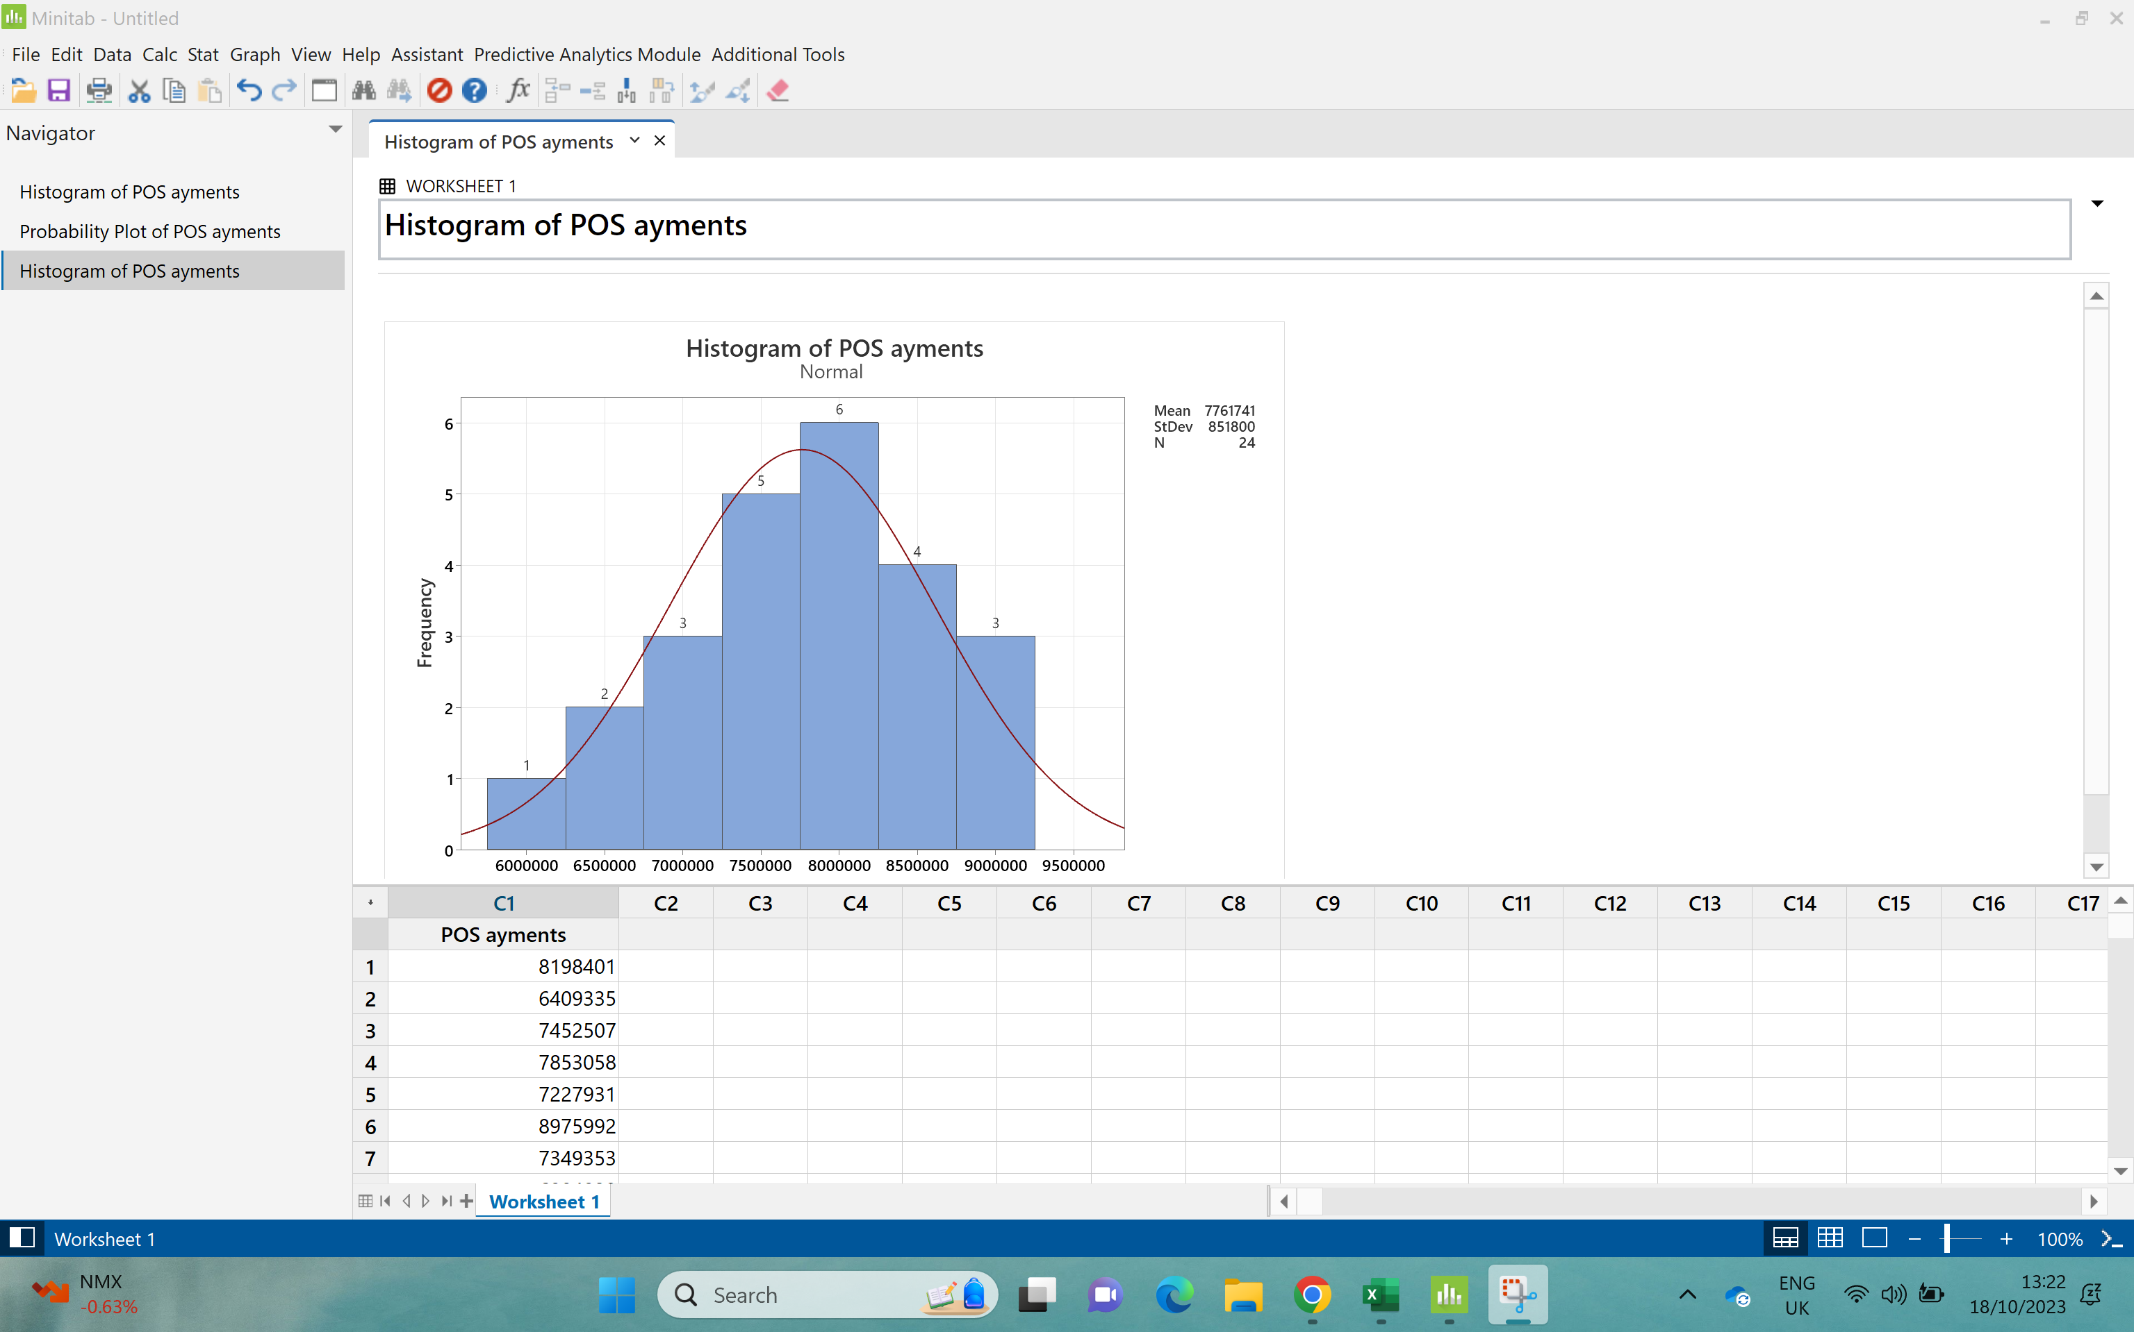
Exercise 1: Process Stability Using the data given in Table 2, determine if the POS performance is stable using a control chart. Explain why you used the type of control chart you selected.

Slide 3
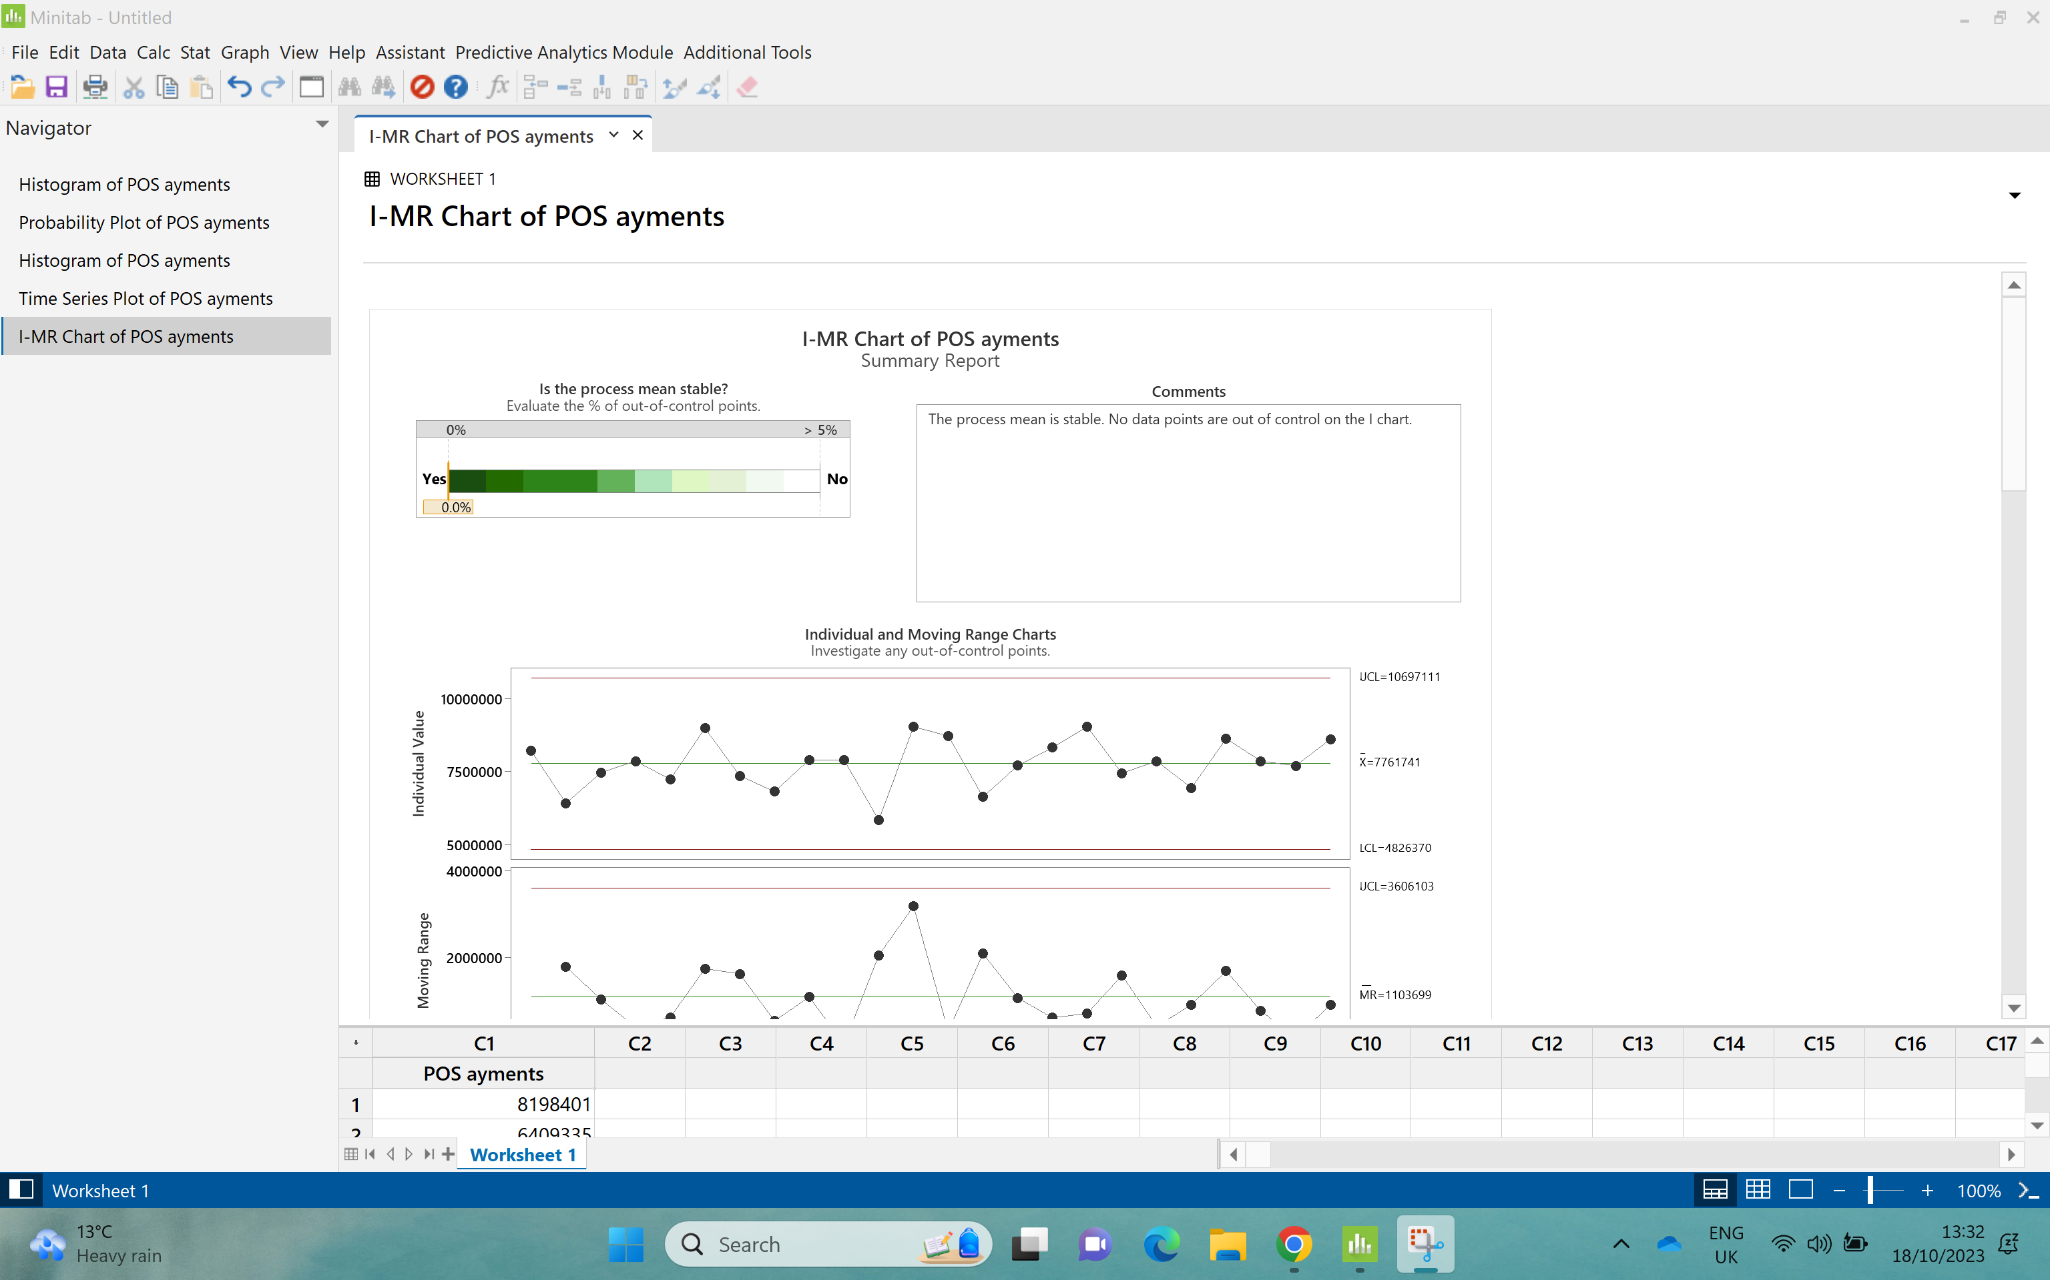

Slide 4
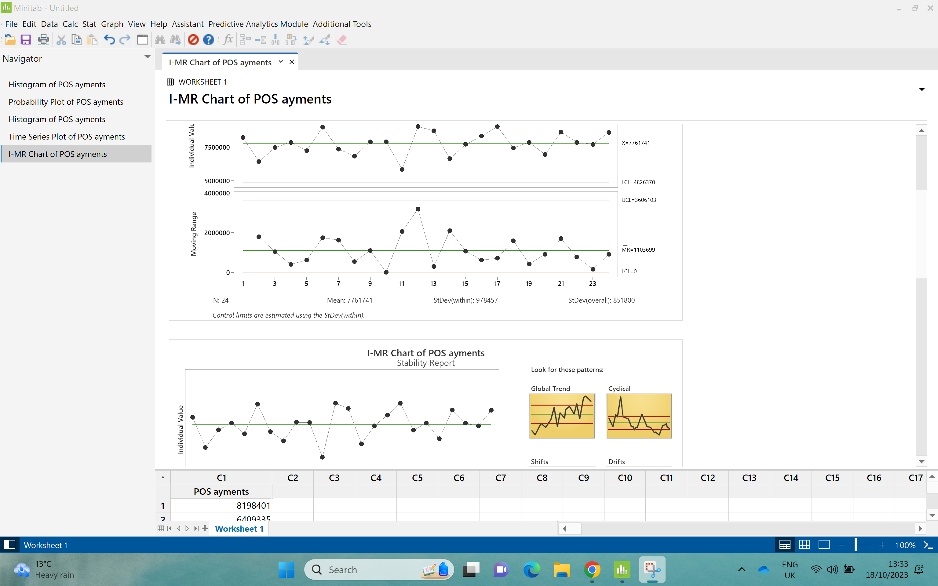

Slide 5
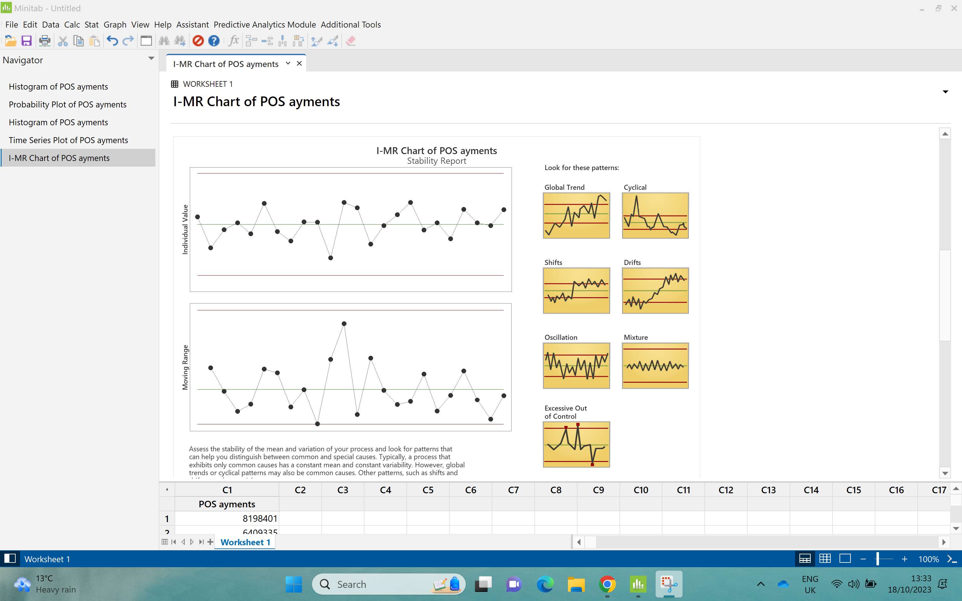

Slide 6
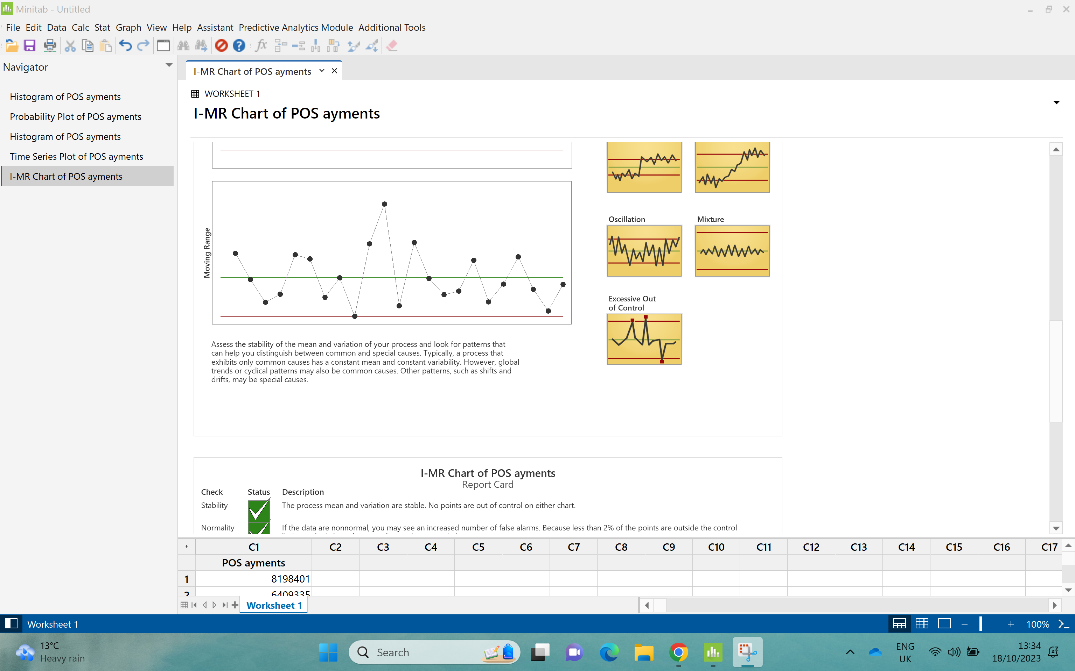

Slide 7
